Slide 1


Data
Analysis

Slide 2


Today's agenda
Project recap
Problem
The Analytics team
Process
Insights
Summary

Slide 3

Client : Social Buzz
Project Scope : Analyzing data to identify top
performing categories.
Objective : Determining the top5 categories based on
scores.
- Understanding client requirements.
- Data gathering and preprocessing.
- Analysis to identify to categories.
Project Recap
Notes:
Social Buzz is a fast growing technology unicorn that need to adapt quickly to it’s global scale.
Accenture has begun a 3 month POC focusing on these tasks:
An audit of Social Buzz’s big data practice
Recommendations for a successful IPO
Analysis to find Social Buzz’s top 5 most popular categories of content
The primary challenge addressed in this presentation is identifying the top 5 categories with the highest scores based on the provided data. This information is crucial for the client to strategize and allocate resources effectively.
Our goal is to provide actionable insights that drive decision-making processes.

Slide 4

Problem
Over 100000 posts per day
36,500,000 pieces of content per year!
But how to Capitalize on it when there is so much?
Analysis to find Social Buzz’s top 5 most popular categories of content
Notes:
In this day and age, content is king. Just look at some of the biggest platforms in the world, for example YouTube, Facebook and Netflix... they are all content businesses...
But how to capitalize on it when there is so much?
It's not just all about harvesting as much content as possible... The real value is in understanding and crunching this content to gain a deeper understanding of your audience and to therefore provide a more personalized and enjoyable experience.
And this is where out data analytics expertise comes in, with the insights that we've uncovered from this task, we can show you exactly how to take analytics to production at scale.

Slide 5



ANDREW FLEMING
Chief Technology Architect
The Analytics team
MARCUS ROMPTON
Senior Principal
GOURAV SINHA
Data Analyst
Notes:
Talking about experience, we have a large data analytics practice at Accenture but we had a team of 3 people primarily focusing on this task. Andrew Fleming is our Chief Technical Architect and his expertise really helped to guide the team to produce high quality analysis.
Marcus Rompton, a senior data expert has worked with the worlds biggest clients on solving their data problems and was heavily involved in the data engineering side of this project.
And finally myself, Gourav, who was solely responsible for taking leadership guidance and delivering high quality insights from the raw datasets and turning these into business decisions.

Slide 6
Process
1
Data Collection
2
Data Preprocessing
3
Exploratory Data Analysis
4
Modelling & Validation
5
Presentation
Notes:
Data Collection:
Gathered relevant data from client sources, ensuring completeness and accuracy.
Data Preprocessing:
Cleaned and prepared the data for analysis, handling missing values and outliers.
Exploratory Data Analysis (EDA):
Conducted exploratory analysis to understand data distribution and patterns.
Modeling:
Utilized appropriate analytical techniques to identify top-performing categories.
Validation:
Validated the results to ensure reliability and accuracy.
Presentation Preparation:
Prepared insights and findings for presentation to the client.

Slide 7
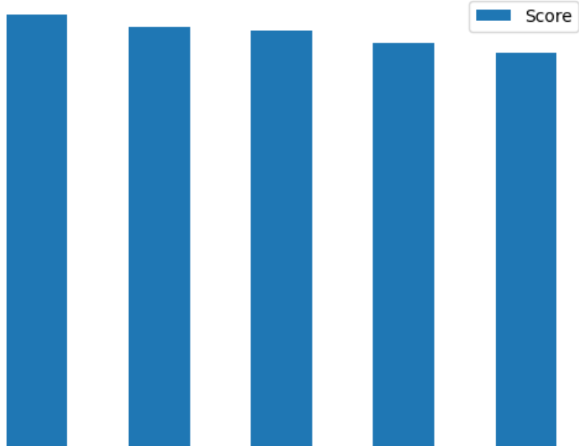
Top 5 Categories by Aggregating “Popularity” score
71242
69067
68521
66549
64952
Categories
Animals Healthy Eating Technology Science Culture
Notes:
From our analysis you can see that the top 5 most popular categories of posts were animals, healthy eating, technology, science and culture in descending order.
Animals: Content related to animals garners significant engagement, indicating a strong interest among users.
Healthy Eating: Health-conscious topics like healthy eating resonate well with the audience, reflecting a growing awareness of wellness.
Technology: Given the digital nature of the platform, technology-related content is popular, reflecting users' interest in innovation and gadgets.
Science: Users show a keen interest in scientific topics, suggesting an appetite for knowledge and discovery.
Culture: Content exploring cultural aspects attracts engagement, indicating an interest in diverse perspectives and traditions.

Slide 8


ANALYSIS
Utilized data analytics to examine user reactions across various content categories.
Identified top 5 categories based on the frequency and intensity of user engagement.
Applied statistical methods to analyze trends and patterns in user behavior.
INSIGHT
Animals emerged as the most popular category, indicating a strong affinity among users for animal-related content.
Healthy Eating and Technology ranked high, reflecting user interests in wellness and innovation.
Science and Culture also garnered significant engagement, showcasing a diverse range of user preferences.
Summary
NEXT STEPS
Refining content curation algorithms to prioritize posts within these categories on user feeds.
Monitoring engagement metrics to track the effectiveness of content strategies and adjust accordingly.
Continuously analyzing user feedback and trends to identify emerging categories and adapt content strategy accordingly.
Notes:
"Through data analytics, we identified the top 5 categories driving user engagement on Social Buzz: Animals, Healthy Eating, Technology, Science, and Culture. Users demonstrate a strong affinity for heartwarming animal stories, health-conscious content, the latest tech innovations, scientific discoveries, and diverse cultural perspectives. To capitalize on these insights, we plan to develop targeted content strategies, optimize algorithms for personalized recommendations, and foster collaborations with influencers and organizations within these categories. Continuous monitoring of user feedback and metrics will enable us to adapt our approach to evolving user preferences and maintain growth."

Slide 9
Thank you!
ANY QUESTIONS?

